Slide 1
Game Theory and Artificial Intelligence Design
tAd cOrDlE, NoLaN LuM

Slide 2
Objectives
To design and develop an AI to play a game developed in-house.
To explore commonly used concepts and theories associated with game theory.
To become familiarized with best practices and common procedures used with source control systems.

Slide 3
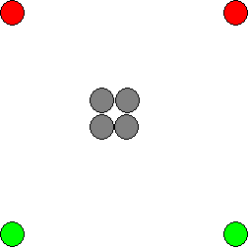
Overview – Blob Wars
The game starts with 2 player-controlled pieces per player.
Grey spaces are immovable and neutral.

Slide 4
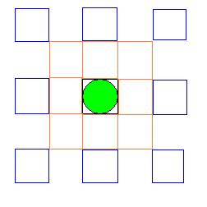
Overview – Blob Wars
Each piece can move to the 9 spaces adjacent, cloning the piece.
It can also jump 2 spaces, but this consumes the original piece.

Slide 5
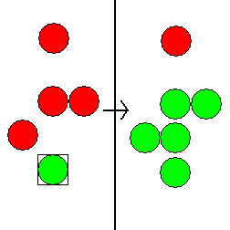
Overview – Blob Wars
Landing a player-controlled piece next to opponent pieces converts the pieces adjacent.
Note that only the 9 pieces adjacent to the piece are converted.

Slide 6
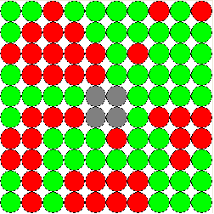
Overview – Blob Wars
The game ends when the board is completely full.
Or, when one player has no moves available.

Slide 7
Important “GamePiece” Class Properties
Class representing a game piece
Properties
Code – returns the type of piece it is and specifies which image to draw on the board
Selected – whether or not the piece is selected by the player
x and y – specify the piece’s position
MoveIsInRange(int xto, int yto)
Returns true if the board position (xto, yto) is within moving range

Slide 8
Important “Board” Class Properties
Class representing a game board
Properties
SIZE_X and SIZE_Y – Constants that represent the size of the game board
GamePiece[][] board – Matrix of game pieces
int[] counts – Keeps track of the number of each type of piece (including empty spaces) on the board
GameOver – Is set to true when there are no empty spaces left or when a player has no moves left

Slide 9
“Board” Class Cont.
Constructors
Load in initial board state from text files
Allows for different kinds of boards to be played on
Index operator this[,] and GetPieceAtPosition(x, y)
Allow for easy access of board contents
Convert (x, y, c1, c2)
Converts all adjacent piece to position (x, y) with code c2 to a piece with code c1
HasMovesLeft(c)
Checks each piece of code c and sees if there is an empty space that can be moved to. If not, return false

Slide 10
“Board” Class Cont.
FillEmptySpaces and DuplicatePiece
Uses recursion to fill all spaces that can be moved to by the specified code with pieces of that code
Used at the end of a game when a player can’t move but another still can
SpaceInBounds(x1, y1, x2, y2)
Returns whether or not the space (x1 + x2, y1 + y2) is still inside the board to avoid IndexOutOfBounds exceptions

Slide 11
Designing the Artificial Intelligence (AI)
Several problems needed to be solved in the design of the AI:
Ranking and categorization of possible moves.
Move search algorithm.
Ranking and categorization of board states.
Moves are explored in a tree-like structure, utilizing a modified depth-first search.

Slide 12
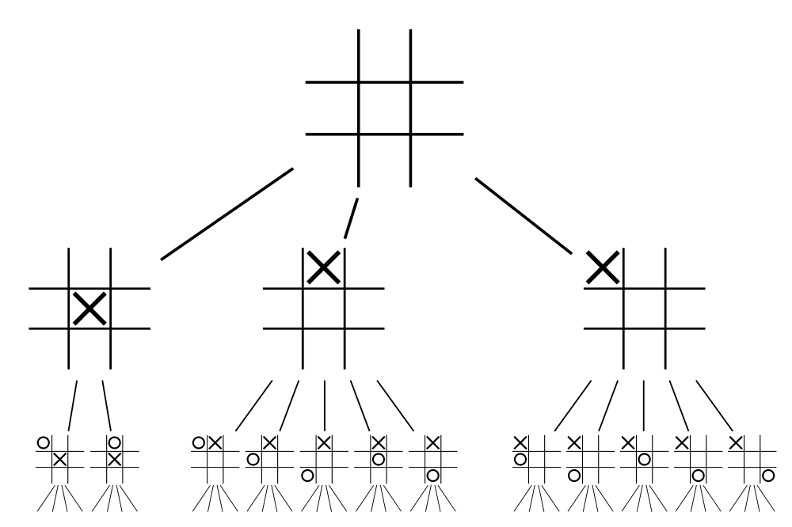
Designing the AI
Exploring the game tree:
Each node is a possible state.
Each branch represents a move.
Each complete level is a “ply”.
Depth First Search
Moves are searched up to a certain “depth”, then exploration proceeds sideways.
An example game tree for tic-tac-toe.

Slide 13
Choosing Moves – The Minimax Algorithm
Minimax is a type of decision making in which the player’s gain is maximized while the player’s loss is simultaneously minimized
The decision tree is explored and each available move is considered
Each maximizing player node takes the highest value of its children nodes as its value
Similarly, each minimizing player node will take the lowest value of its children

Slide 14
Minimax Overview
-Black circles will represent
the AI (aiming for highest
score) and white circles will
represent the opponent (wants
to minimize the player’s score)
-Maximizing nodes simply take
the highest value of its children
-Minimizing nodes take the
lowest value
-The values of the bottom nodes
are the heuristic value of the
board state that each of those
nodes represent
7
7
7
4
2
7
7
9
4
2
5
4
7
1
9
4
3
1
2
5
Therefore, black nodes will choose the highest values and white nodes will choose the lowest

Slide 15
Minimax Overview Cont.
Once all of the values of the tree are covered, the AI will execute whichever move leads to the highest score
In the case of our tree, the AI will choose the move that leads to the immediate score of 7 because that is the highest calculated score
7
7
4
2

Slide 16
Minimax pseudocode
int minimax(Node node, int currentDepth)
{
if (currentDepth <= 0 or game over at node)
return heuristic value of node
int a = -infinity
foreach child in node
a = max (a, -minimax(child, currentDepth – 1))
return a
}

Slide 17
Problems with Minimax
Minimax requires total search of decision tree
With games like blob wars, it would take an extremely long time to search every possible move at even low search depths
Each piece can have up to 16 possible moves
With an 8x8 game board (about 64 spaces), millions of nodes could be generated at just a search depth of 4

Slide 18
Alpha-Beta Pruning
An optomized form of mini-max
Avoids searching through unnecessary nodes
When searching through the game tree, if a value is found that is worse than the best value the minimizing opponent can choose for you, you can stop searching through that node because you know that no better score will be generated from that node
That makes no sense but it’s okay

Slide 19
Alpha-Beta Overview
-Here is a new tree (this
time, however, the entire
tree will not be searched)
-Two values are used to
keep track of the scoring
bounds of our search:
Alpha (a) and
Beta (B)
3
8
2
5
7
9
0
2
5
3
2
6
Alpha is the maximum lower bound of possible solutions
Beta is the minimum upper bound of possible solutions

Slide 20
Alpha-Beta Overview
The first value hit is a 3.
Since this is the child of a minimizing node, we know that the minimax value of this node must be less than or equal to 3. We set the beta of its parent node to 3.
The next child is greater than the beta value, which means it is higher than the current min value. This new node is ignored
3
B=3
3
8
All children have been searched, so the value of the minimizing node is set to the beta value

Slide 21
Alpha-Beta Overview
So far, the higest value the max node can achieve is 3, so we set a to 3. The rest of max’s children are searched and the alpha value is passed down
a=3
3
B=3
3
a=3
3
B=3
The value is 2. From just this node, we know that the minimizing player will achieve a value of AT MOST 2. However, our alpha value is 3, which means the max player already has found move that returns a higher score than what this node can provide. This means we already know we don’t have to search this node anymore.
a=3
a=7
a=3
3
B=3
7
3
a=3
a=3
3
2
B=2
7
The max node’s
children have all
been searched, so
we set the value of
the max node to a
a=3
B=2
2
3
B=3
B=3
B=3
3
8
2
7
2
3

Slide 22
Comparison
Without pruning
With pruning

Slide 23
Alpha-Beta Overview Cont.
This pattern continues, passing alpha (max) and beta (min) values between nodes in order to eliminate unnecessary searching
This drastically improves the run time of the program

Slide 24
Alpha-Beta Pruning Pseudocode
int AlphaBeta(int depth, int alpha, int beta)
{
if (depth == 0)
return Evaluate();
GenerateLegalMoves();
while (MovesLeft()) {
MakeNextMove();
val = -AlphaBeta(depth - 1, -beta, -alpha);
UnmakeMove();
if (val >= beta)
return beta;
if (val > alpha)
alpha = val;
}
return alpha;
}

Slide 25
Alpha Beta in Blob Wars
There’s too much code to put here D:

